Slide 1
Trend for Precision Soil Testing % Zone or Grid Samples Tested compared to Total Samples

Slide 2
%Zone or Grid Samples Tested Compared to Conventional Whole Field Composite Samples in 2015

Slide 3
AGVISE Laboratories %Zone or Grid Samples – Northwood laboratory 1997 - 2015
% Grid or Zone Samples Tested Compared To
Conventional Whole Field Composite Samples Tested

Slide 4
Average Soil Nitrate following Wheat in 2015
MB
Fall 2015 Samples
52
42
(lb/a 0-24” samples)
49
52
24
49
46
43
38
36
37
43
43
ND
34
35
36
33
38
29
41
47
48
MN
SD
41
55

Slide 5
Average Soil Nitrate Following “Wheat” 1986 – 2015 (0-24” lb/a)
Nitrate-N (0-24” lb/a)

Slide 6
Soil Nitrate Variability Between Fields Following “WHEAT” in 2015

Slide 7
Average Soil Nitrate Following “Wheat” (1986-2015) “Deep N” (24-48” lb/a)
Nitrate-N (0-24” lb/a)

Slide 8
Average Soil Nitrate Following “Barley” 1986 - 2015
Nitrate-N (0-24” lb/a)

Slide 9
Soil Nitrate Variability Between Fields Following “Barley” in 2015

Slide 10
Average Soil Nitrate Following “Sunflower” 1986 - 2015
Nitrate-N (0-24” lb/a)

Slide 11
Soil Nitrate Variability Between Fields Following “Sunflower” in 2015

Slide 12
Average Soil Nitrate Following “Drybeans” 1986 - 2015
Nitrate-N (0-24” lb/a)

Slide 13
Soil Nitrate Variability Between Fields Following “Dry Beans” in 2015

Slide 14
Average Soil Nitrate Following “Sugarbeets” 1986 - 2015
Nitrate-N (0-24” lb/a)

Slide 15
Soil Nitrate Variability Between Fields Following “Sugarbeet” in 2015

Slide 16
Average Soil Nitrate Following “Fallow” 1986 - 2015
Nitrate-N (0-24” lb/a)

Slide 17
Soil Nitrate Variability Between Fields Following “Fallow” in 2015

Slide 18
Average Soil Nitrate following Soybean in 2015
Fall 2015 samples
MB
28
27
(lb/a 0-24” samples)
31
33
30
22
31
36
43
27
33
29
33
24
ND
28
27
22
27
24
28
29
MN
SD
31
24
30
39
44

Slide 19
Average Soil Nitrate Following “Soybeans” 1995 - 2015
Nitrate-N (0-24” lb/a)

Slide 20
Soil Nitrate Variability Between Fields Following “Soybeans” in 2015

Slide 21
Average Soil Nitrate following Corn in 2015
Fall 2015 samples
MB
(lb/a 0-24” samples)
50
74
69
68
52
51
49
ND
35
37
49
57
60
68
63
84
MN
SD
68
33
81
78

Slide 22
Average Soil Nitrate Following “Corn” 1997 – 2015 (Northwood Laboratory)
Nitrate-N (0-24” lb/a)

Slide 23
Soil Nitrate Variability Between Fields Following “Corn” in 2015

Slide 24
% Soil Samples with Phosphorus less than 10 ppm
Fall 2015 samples
MB
41%
(0-6” samples)
47%
(Olsen P test)
48%
16%
64%
68%
43%
32%
24%
77%
74%
71%
53%
69%
58%
ND
47%
56%
66%
50%
54%
37%
71%
40%
52%
MN
SD
36%
38%
32%
49%
33%
37%

Slide 25
% Soil Samples with Potassium less than 150 ppm
MB
Fall 2015 samples
37%
13%
(0-6” samples)
30%
30%
31%
6%
19%
15%
27%
4%
2%
5%
16%
76%
ND
36%
8%
7%
19%
45%
71%
6%
45%
2%
6%
28%
MN
SD
34%
36%
1%
5%
33%
39%

Slide 26
% Soil Samples with Zinc less than 1.0 ppm
MB
Fall 2015 samples
49%
61%
(0-6” samples)
51%
28%
59%
76%
52%
31%
36%
90%
81%
75%
49%
ND
66%
40%
50%
78%
69%
58%
47
29%
24%
77%
44%
53%
MN
SD
26%
60%
34%
43%
34%
24%

Slide 27
% Soil Samples with Sulfur less than 15 lb/a
MB
Fall 2015 samples
6%
24%
(0-6” samples)
14%
9%
21%
7%
22%
19%
20%
56%
25%
18%
13%
35%
ND
23%
39%
66%
47%
58%
19%
32%
67%
75%
35%
46%
MN
SD
58%
74%
71%
38%
60%
84%

Slide 28
% Soil Samples with %OM less than 3.0%
MB
Fall 2015 Samples
7%
10%
(0-6” samples)
22%
31%
22%
19%
31%
20%
24%
67%
44%
34%
22%
ND
21%
33%
60%
35%
77%
34%
25%
29%
30%
52%
27%
11%
MN
SD
11%
28%
30%
7%
5%
23%

Slide 29
% Soil Samples with Chloride less than 40 lb/a
MB
Fall 2015 Samples
38%
66%
(0-24” samples)
56%
22%
56%
54%
47%
39%
54%
87%
70%
53%
41%
ND
44%
62%
67%
89%
88%
51%
59%
90%
90%
54%
63%
MN
SD
78%
83%
55%
72%

Slide 30
% Soil Samples with Copper less than 0.5 ppm
MB
Fall 2015 samples
18%
4%
(0-6” samples)
30%
33%
9%
15%
14%
16%
26%
4%
3%
14%
14%
ND
38%
43%
13%
51%
10%
18%
13%
27%
27%
16%
7%
6%
MN
SD
9%
6%
6%
3%
1%

Slide 31
% Soil Samples with Boron less than 0.4 ppm
MB
Fall 2015 samples
1%
1%
(0-6” samples)
3%
8%
7%
1%
10%
3%
13%
15%
7%
4%
9%
9%
23%
ND
7%
22%
6%
38%
78%
26%
44%
27%
16%
7%
11%
MN
SD
18%
7%
21%
35%
14%

Slide 32
% Soil Samples with Soil pH greater than 7.3
MB
Fall 2015 samples
69%
89%
(0-6” samples)
74%
77%
92%
77%
59%
73%
75
66%
50%
74%
78%
96%
63%
ND
37%
6%
45%
30%
66%
78%
44%
11%
25%
MN
SD
41%
58%
28%
27%
19%
25%
22%

Slide 33
% Soil Samples with Soil pH less than 6.0
MB
Fall 2015 samples
2%
0%
(0-6” samples)
5%
4%
0%
1%
17%
2%
4%
3%
6%
1%
3%
1%
7%
ND
1%
52%
15%
13%
3%
5%
16%
27%
17%
MN
SD
11%
18%
25%
36%
29%
21%
13%
39%

Slide 34
% Subsoil Samples with pH less than 7.0
MB
Fall 2015 samples
2%
0%
(0-6” samples)
5%
3%
0%
1%
15%
3%
2%
1%
1%
1%
2%
0%
1%
ND
3%
52%
6%
7%
2%
1%
9%
17%
9%
MN
SD
3%
3%
25%
23%
29%
10%
6%
19%

Slide 35
% Soil Samples with Carbonate greater than 5.0%
MB
Fall 2015 samples
40%
58%
(0-6” samples)
22%
21%
22%
5%
16%
9%
31%
13%
6%
11
29%
ND
23%
5%
5%
4%
11%
28%
6%
3%
0%
1%
MN
SD
12%
23%
2%
1%
4%
9%

Slide 36
% Soil Samples with Salts greater than 1.0
MB
Fall 2015 Samples
13%
11%
(0-6” samples)
9%
18%
5%
12%
8%
14%
18%
3%
8%
19%
35%
ND
15%
9%
3%
10%
2%
24%
13%
3%
2%
18%
MN
SD
9%
4%
1%
1%
3%
11%
3%

Slide 37
North Dakota & NW Minnesota % Samples Testing with Salts greater than 1.0
582 Grand
Forks
567 TRF
587 Minot
1:1 salt method – expressed as mmhos/cm

Slide 38
South Dakota - % Samples Testing with Salts greater than 1.0
1:1 salt method – expressed as mmhos/cm

Slide 39
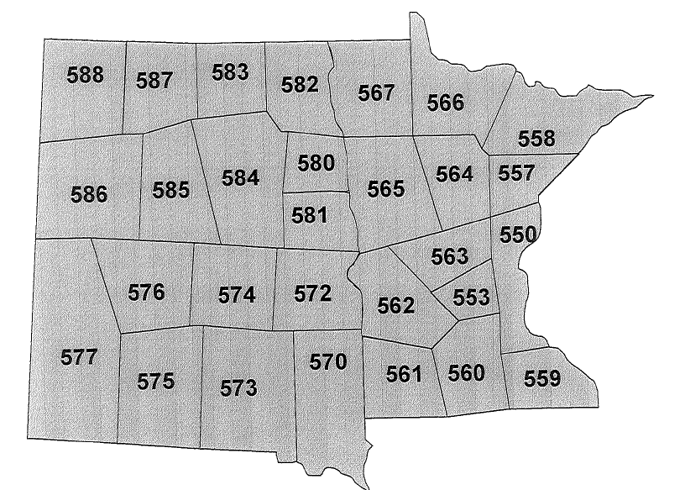
Zip Code Areas For Soil Test Summaries
ND
MN
SD

